Slide 1



4CS015
Fundamentals of Computing
1

Slide 2
A. Agenda
Introduction to your Instructors
Introduction to the Module
Week 1 Lecture on Fundamentals of Computing
Agenda
Instructors
2

Slide 3
B. Instructors
Uttam Acharya (Module Leader)
MSc. Physics, TU
uttam.acharya@heraldcollege.edu.np
Sanjeev Rai (Lecturer)
MCA (Masters of Computer Application), PU
sanjeev.chamling@bicnepal.edu.np
Bhismaraj Koirala (Tutor )
BE(Bachelor of Computer Engineering),TU
Sandhya Tiwari (Tutor )
BIM(Bachelor of Information Management),TU
Agenda
Instructors
Module Overview
Agenda
Instructors
3

Slide 4
C. Module Overview
Week 1: Number and Data representation
Week 2: Digital Electronics
Week 3: Combinational Circuits
Week 4: Arithmetic Logic Units
Week 5: Sequential logic
Week 6: Memory
Week 7: CPU Architecture and Peripheral Devices
Week 8: Windows Operating System and Command line Interface
Week 9: Exam Week
Week 10: Linux Operating system and Command line
Week 11: Batch file for Windows OS
Week 12: Networking and Final Portfolio Submission
Instructors
Module Overview
Teaching Strategy
4

Slide 5
C. Module Overview
This module has two distinct halves.
Weeks 1 – 6
The first half looks at the relationships between number systems, Boolean algebra, logic gates and digital electronic circuit design.
By the end, you should have a good understanding of how a computer works and why it works that way.
Weeks 7 – 12
The second half examines how Computer Scientists get the most out of computers.
You’ll look at how we work with computers that don’t have ‘point and click’ front ends, how we communicate with other computers and how to store and access data.
Instructors
Module Overview
Teaching Strategy
5

Slide 6
D. Teaching Strategy
Taught over 1 Semester – 12 Weeks
Each Week Consists of:
1 Lecture: 2 hrs => Discuss the conceptual idea of the topic
1 Tutorial:2 hrs =>Discuss to clear confusions
1 Workshop 2.5 hrs =>Practice the concept and ideas
Module Overview
Teaching Strategy
Recommended
Textbooks
6

Slide 7
E. Recommended Textbooks:
Teaching Strategy
Recommended
Textbooks
Module grading system in UK
Computer System Architecture
M. Morris Mano (Pearson, 3 Edition )
rd
Logic and Computer Design Fundamentals
M. Morris Mano and C.R. Cime (Pearson,2008)
7

Slide 8
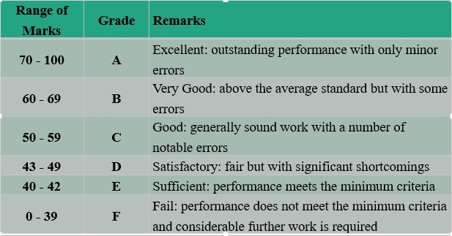
F. Module grading system in UK
Recommended Textbooks
Module grading
system in UK
Any Questions?
8

Slide 9
Weekly Study Hour
Credits Hours Breakdown
Each of your module carries 20 Credits
Total Learning Time: 20 Credits x 10 hrs= 200 hrs. (Since 1 Credit = 10 Hours of Learning Hours)
Guided Learning (Comprises of LTW sessions):
35% of Total Learning Hours (200 hrs.) = 70 Hours
Unguided Learning (Comprises of self-studies and time taken for the assessments):
65% of Total Learning Hours (200 hrs.) = 130 Hours
9
G. Classroom Code
H. Weekly Study our
1. Lecture 1

Slide 10
Lecture-1 Number and Data Representation

Slide 11
2. Overview
Representation of Numbers
Base/Radix:
1. Lecture- 1
Decimal
Binary
Octal
Hexadecimal
2. Overview
2.1 Some Definitions
Unsigned and Signed numbers
Two’s Complement Subtraction
Non-integer numbers

Slide 12
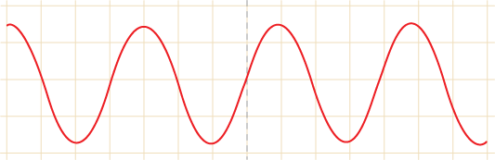
2.1 Some Definitions
2.1.1 Analogue
Continuous signals
Some Definitions
Analogue
Digital
Represented by sine waves
Human voice, sound, light are a few examples
Pic Ref: bbc.co.uk
12

Slide 13
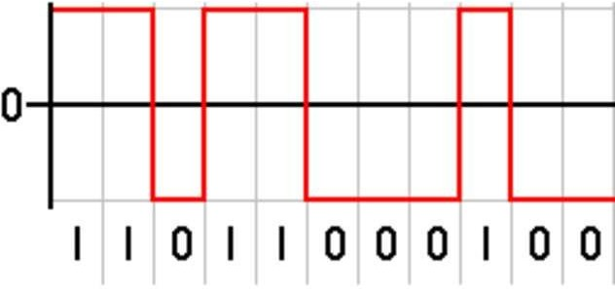
2.1.2 Digital –
Discrete signals
Some Definitions
Analogue
Digital
Represented by square waves
For example, electricity
Pic Ref: answers.com
13

Slide 14
2.1.3 Digital Electronics
Digital electronics takes different values (or ranges of values) of analogue signals to represent different, discrete, values.
As an example, consider a light switch A light switch only has two positions.
When it is ‘off’, we would measure 0 volts at the supply to the light.
When it is ‘on’, we would measure 240 volts at the supply to the light.
Thus, we can represent ‘on’ and ‘off’, or ‘0’ and ‘1’, with two arbitrary analogue values; ‘0’ and ‘240’ (In the USA,
Some Definitions
Analogue
Digital
Digital Electronics
they use ‘0’ and ‘110’).
14

Slide 15
2.2 Representation
All information when stored in a computer system, must use some form of internal representation
2.2 Representation
2.3 Radix or Base
The program to be executed.
The numerical data to be processed.
Character strings ( A....Z etc. ).
15

Slide 16
2.3 RADIX or BASE
In any number scheme the base value defines the number of unique symbols. In the Decimal scheme we use the symbols: 0,1,2,3,4,5,6,7,8,9.
The highest symbol = BASE –1.
2.3 RADIX or BASE
2.4The Decimal
System
2.5 Binary
All Symbol values are UNIQUE.
Example: 11₁₀
16

Slide 17
2.3 The Decimal System
What is a Decimal Value?
What does 331 really mean?
The position of each digit is assigned a weight.
Decimal Scheme right-most digit has a weight of 10⁰ = 1.
Weighting increases by a factor of 10 for each new symbol as the position moves to the left.
2.3 The Decimal
System
2.3.1 Decimal
Example
17

Slide 18
2.3.1 Decimal Example
Again taking the value 331:
2.3 The Decimal
System
2.3.1 Decimal Example
2.4 The Binary
10² | 10¹ | 10⁰
3 | 3 | 1
3 * 100 | 3 * 10 | 1 * 1
300 | 30 | 1
Value = 300 + 30 +1.
18

Slide 19
2.4 Binary
Binary number system follows similar rules to decimal system.
Except base is 2 not 10.
By the BASE rules:
Symbols: 0, 1 (all symbols are unique) Highest Symbol = BASE - 1.
BASE = 2 this is BINARY.
Example: 11₂
19
2.3.1 Decimal example
2.4 Binary

Slide 20
3. The Binary Representation Scheme
Taking a simple value: 01011010
The Binary Representation Scheme
Basic Conversion
Decimal to Binary Conversion
₂7 | ₂6 | ₂5 | ₂4 | ₂3 | ₂2 | ₂1 | ₂0
128 | 64 | 32 | 16 | 8 | 4 | 2 | 1
0 | 1 | 0 | 1 | 1 | 0 | 1 | 0
Can you tell what this value is?
20

Slide 21
3.1 Basic Conversion
Converting this representation back to a more familiar DECIMAL form we can see that all the information necessary about the data is available.
3. The Binary
Representation Scheme
3.1 Basic Conversion
3.2 Decimal to Binary Conversion
₂7 | ₂6 | ₂5 | ₂4 | ₂3 | ₂2 | ₂1 | ₂0
0 | 1 | 0 | 1 | 1 | 0 | 1 | 0
0*128 | 1*64 | 0*32 | 1*16 | 1*8 | 0*4 | 1*2 | 0*1
0 + 64 + 0 + 16 + 8 + 0 + 2 + 0 = 90
21

Slide 22
3.2 Decimal To Binary Conversion
Rules:
Divide the number by 2.
Look at the remainder ‘1’ or ‘0’.
Use the remainder as Bit value.
Loop till done.
Convert 25₁₀
3. The Binary
Representation Scheme
3.1 Basic Conversion
3.2 Decimal to Binary
Conversion
22

Slide 23
3.2.1 Example: Conversion of 25₁₀
Divisor | Quotient | Remainder
2 | 25 | 1 LSB
2 | 12 | 0
2 | 6 | 0
2 | 3 | 1
2 | 1 | 1 MSB
 | 0
Decimal to Binary Conversion
Example
Binary Value = 11001₂

Slide 24
3.3 Binary To Decimal Conversion
Calculate the value for each Digit Position as (Symbol * Base Weighting) for the position. Then sum all these values.
Binary 1110₂
= (1 * 2³) + (1 * 2²) + (1 * 2¹) + (0 * 2⁰)
= (1 * 8) + (1 * 4) + (1 * 2) + (0 * 1)
= 14₁₀
3.3 Binary to Decimal
Conversion
3.4 Most Significant
Digit /
Least Significant Digit
4. 'Bits', 'Bytes' and
'Words'

Slide 25
3.4 Most Significant Digit / Least Significant Digit
The concepts of the significance of the Symbol positions is not unique to binary.
Units, Tens, Hundreds etc. In the decimal scheme.
Most Significant Digit is the Left - most symbol of the Number.
Least Significant Digit is the Right – most symbol of the Number.
Example: 11001₂
3.3 Binary to Decimal
Conversion
3.4 Most Significant
Digit /
Least Significant Digit
4. 'Bits', 'Bytes' and
'Words'

Slide 26
4. 'Bits', 'Bytes' and 'Words'
Within a computer system EVERYTHING is stored or used in binary format.
Each Binary Digit is commonly known as a
Bit.
Within any computer system information is stored or manipulated in groups of ‘n Bits’.
3.4 Most Significant
Digit /
Least Significant Digit
4. 'Bits', 'Bytes' and
'Words’
5.Unsigned Numbers

Slide 27
4. 'Bits', 'Bytes' and 'Words'
A Byte is the smallest grouping and it is defined to contain ‘n’ Bits. By common usage, the Byte usually refers to a grouping of 8 Bits.
A Word is a larger grouping of Bits.
Size reflected by a PC’s architecture.
Again by common usage, a Word is a grouping of 16 Bits
and therefore is 2 Bytes.
We also have Nibbles
Which are?
3.4 Most Significant
Digit /
Least Significant Digit
4. 'Bits', 'Bytes' and
'Words’
5.Unsigned Numbers

Slide 28
5.Unsigned Numbers
Any number range is defined as:
0 Max Number.
In the Decimal scheme, if we write a value as 27:
The magnitude of the value is 27.
By convention the value is Positive.
On the other hand if we write the value as: -27
It is not the same since the '-' SIGN identifies it as another value.
4. 'Bits', 'Bytes' and
'Words’
5.Unsigned Numbers

Slide 29
5.1 Unsigned Binary Representation
The Binary representation in an unsigned form has only a MAGNITUDE.
All binary combinations of the "n" Bits will uniquely identify a magnitude
5.Unsigned Numbers
5.1 Unsigned Binary
Representation
5.2 Kilo-Mega-Giga
5.3 Unsigned Number
Tables
e.g. 0000 1111.
Range 0 to 2^{n} -1
So program variable declarations can define the size and type of storage used!

Slide 30
5.2 Kilo - Mega - Giga
Within Binary these terms have slightly different
meaning to those in Decimal.
Kilo = 10³ = 1000 in Decimal.
Kilo = 2¹⁰ = 1024 in Binary.
Mega = Kilo * Kilo = (Kilo²).
1,048,576 Binary / 1,000,000 Decimal.
Decimal: Mega = 10⁶ / Binary: Mega = 2²⁰.
Giga = Kilo * Mega.
5.Unsigned Numbers
₂0 | 1
₂1 | 2
₂2 | 4
₂3 | 8
.. | ..
₂9 | 512
₂10 | 1K
₂11 | 2K
₂20 | 1M
₂30 | 1G
₂40 | 1T
5.1 Unsigned Binary
Representation
5.2 Kilo-Mega-Giga
5.3 Unsigned Number
Tables

Slide 31
5.3 Unsigned Numbers Table
Look at this table of 16 values we need ‘4’ Bits’
to represent all possible values.
Unsigned Numbers
Unsigned Binary
Representation
Kilo-Mega-Giga
Unsigned Number Table
Decimal | Binary |  | Decimal | Binary
0 | 0000 |  | 8 | 1000
1 | 0001 |  | 9 | 1001
2 | 0010 |  | 10 | 1010
3 | 0011 |  | 11 | 1011
4 | 0100 |  | 12 | 1100
5 | 0101 |  | 13 | 1101
6 | 0110 |  | 14 | 1110
7 | 0111 |  | 15 | 1111

Slide 32
6. Signed Numbers
The Decimal number system uses ‘-‘ (minus)
In Binary we only have two symbols 1 and 0.
But we must be able to store signed numbers in computer memory!
One possible solution - signed magnitude
00010111 = +23
sign magnitude
6. Signed Numbers
7. Radix Complement
10010111 = -23
sign magnitude

Slide 33
6. Signed Numbers
What effect does this have on the size of integers a computer can use?
8 bit unsigned binary number
00000000 - 11111111
0 - 255₁₀
8 bit signed binary number
01111111 - 11111111
+127₁₀ - -127₁₀
Range (2^{n-1} -1) to 2^{n-1} -1
Signed Numbers
Radix Complement
but we have 00000000 and 10000000 Is this a problem?
33

Slide 34
7. Radix complement
2's complement
Variation of sign magnitude but has some very useful characteristics.
Subtraction becomes complementary addition.
Convert -ve numbers to 2's complement and then add.
Get subtraction through adding a negative. 30 + (-30) = 0
Signed Numbers
Radix Complement

Slide 35
7.1 Subtraction and Two’s Complement
To create the 2’s complement of a negative number.
Invert all '1's to '0' and '0's to '1’
Add 1.
Each operand must have same number of bits.
Radix Complement
Subtraction and Two’s Complement 7.1.1Subtraction and 2’s Complement
Example 25 - 7
25 = 00011001
7 = 00000111

Slide 36
7.1.1 Subtraction and 2’s Comp
First convert -7 to 2's complement
Step 1 : form 1's complement
00000111
Subtraction and Two’s Complement
Subtraction and 2’s Complement
7.1.2 2’s complement answers
11111000
Step 2 : add 1
11111000
+1
1's complement
11111001 -7 in 2's complement representation

Slide 37
7.1.1 Subtraction and 2’s Comp
Subtraction and Two’s Complement
Subtraction and 2’s Complement
7.1.2 2’s complement answers
Now add
25 = 00011001
-7 = 11111001
Ans =100010010
The binary result 00010010₂ is 18 in decimal
//ignore the carry bit if overflow occurs
Check answer.

Slide 38
7.1.1 Subtraction and 2’s Comp
Another Example 7-25
25 = 00011001
7 = 00000111
Subtraction and Two’s Complement
Subtraction and 2’s Complement
7.1.2 2’s complement answers
First convert -25 to 2's complement
Step 1 : form 1's complement
00011001
11100110
Step 2 : add 1
11100110
+1
1's complement
11100111 -25 in 2's complement representation
38

Slide 39
7.1.1 Subtraction and 2’s Comp
Now add
Subtraction and Two’s Complement
Subtraction and 2’s Complement
7.1.2 2’s complement answers
7 = 00000111
-25 = 11100111
Ans = 11101110
The binary result is 11101110₂, which is a negative number (since the most significant bit is 1).
To find the magnitude, take the 2's complement of 11101110₂​:
Invert the bits: 00010001₂
Add 1: 00010001+1=00010010₂​=18 in decimal.
Since the original result was negative, the answer is −18.
Final Answer : 7−25=−18 using 2's complement arithmetic.
39

Slide 40
7.1.2 2’s complement answers.
ONLY CONVERT NEGATIVE NUMBERS!
When working out the real answer of a 2’s complement sum.
1. Look at the most significant bit.
2. If it is a 1 then
The answer is negative
Change all ones to zero, all zeros to one and add one.
Convert this to decimal and write the sign.
Subtraction and Two’s Complement
Subtraction and 2’s Complement
7.1.2 2’s complement answers

Slide 41
Example
Subtraction and Two’s Complement
Subtraction and 2’s Complement
7.1.2 2’s complement answers Example
Which of the following numbers are correctly converted to 8 bit 2’s complement?
-33₁₀ = 00011111₂
-30 = 10011000
30 = 00011110
I really don’t know
8
10

Slide 42
7.2 2’s Comp and Sign Magnitude
Binary | S/M | 2's Comp
00000000 | 0 | 0
00000001 | 1 | 1
00000010 | 2 | 2
····· | ····· | ·····
01111110 | 126 | 126
01111111 | 127 | 127
10000000 | -0 | -128
10000001 | -1 | -127
····· | ····· | ·····
11111110 | -126 | -2
11111111 | -127 | -1
7.2 2’s Comp and Sign Magnitude

Slide 43
7.2 2‘s Comp and Sign Magnitude
Number range for 2's complement 8 and 16 bit integers?
-128 to +127
-32768 to +32767
Range -(2^{n-1}) to + 2^{n-1} -1
8 bit
16 bit
7.2 2’s Comp and Sign Magnitude
Number range for the sign magnitude representation for 8 and 16 bit integers?
-127 to +127
-32767 to +32767
8 bit
16 bit
Range -(2^{n-1} -1) to + 2^{n-1} -1

Slide 44
8. Hexadecimal (Hex)
Hexadecimal
(Hex)
Conversion of Hexadecimal to/from Decimal
Binary to Hexadecimal Conversion
Binary &Hex Conversion
Making Binary easier for Humans
Hexadecimal (Hex) number system is base 16.
16 unique symbols.
Symbols: 0,1,2,3,4,5,6,7,8,9,A,B,C,D,E,F.
A = 10 , B = 11 , C = 12 ,
10 10 10
D = 13₁₀, E = 14₁₀, F = 15₁₀.
Example: 3E8₁₆ = 1000₁₀.

Slide 45
8. Hexadecimal (Hex)
Hexadecimal (Hex)
Hexadecimal to/from Decimal
Binary to Hexadecimal Conversion
Binary &Hex Conversion
Making Binary easier for Humans
Weight is 16 raised to the power of the position.
Example: A1F₁₆
(A x 16²) + | (1 x 16¹) + | (F x 16⁰)
16²= 256 | 16 | 1
10 x 256 + | 1 x 16 | 15 x 1 | =2591₁₀

Slide 46
8.1 Conversion of Hexadecimal to/from Decimal
Hexadecimal
(Hex)
Conversion of Hexadecimal to/from Decimal
Binary to Hexadecimal Conversion
Binary &Hex Conversion
Making Binary easier for Humans
Hex 9AC₁₆
(9 * 16²)+ (A * 16¹) + (C * 16⁰) = 2476
2304 + 160 + 12 = 2476
1371
Divisor | Quotient | Remainder
16 | 1371 | 11 =B
16 | 85 | 5
16 | 5 | 5
 | 0
10
Result = 55B₁₆

Slide 47
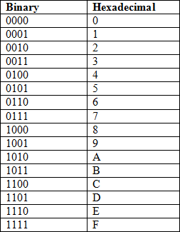
8.2 Binary to Hexadecimal Conversion
Hexadecimal
(Hex)
Conversion of Hexadecimal to/from Decimal
Binary to Hexadecimal Conversion
Binary &Hex Conversion
Making Binary easier for Humans
Comparison of the binary and hexadecimal number systems.
What do you notice?

Slide 48
8.2 Binary to Hexadecimal Conversion
Hexadecimal
(Hex)
Conversion of Hexadecimal to/from Decimal
Binary to Hexadecimal Conversion
Binary &Hex Conversion
Making Binary easier for Humans
A single Hex digit can represent a 4-bit binary number.
Example: (110101111)
2
0001 | 1010 | 1111
1 | A | F
(110101111)₂
= (1AF)₁₆

Slide 49
8.3 Binary & Hex Conversion
Hexadecimal
(Hex)
Conversion of Hexadecimal to/from Decimal
Binary to Hexadecimal Conversion
Binary &Hex Conversion
Making Binary easier for Humans
Consider the value:
₂7 | ₂6 | ₂5 | ₂4 | ₂3 | ₂2 | ₂1 | ₂0
0 | 1 | 0 | 1 | 1 | 0 | 1 | 1
Split this into groupings of 4 Bits
This gives the Hex – 5B₁₆
Hex is simply groupings of 4 Binary Bits.

Slide 50
8.4 Making Binary Easier for Humans
Hexadecimal (Hex)
Conversion of Hexadecimal to/from Decimal
Binary to Hexadecimal Conversion
Binary &Hex Conversion
Making Binary
easier for Humans
Why was Hexadecimal chosen?
Single hex digit = four bits.
2 hex digits per byte.
Allows simple conversion to and from binary.
Simpler to convert between Base 2 and Base 10.
The meaning of a value can be communicated simply and effectively, both at the computer (i.e. Base 2) level and also so that humans (i.e. Base 10) can visualise the meaning.
Hex is easier for humans to understand and communicate.
Example: A₁₆ = 1010₂ = 10₁₀.

Slide 51
9. OCTAL Radix 8
The only other commonly used number base is 8 or Octal.
Why use octal?
Direct conversion to binary
How would you represent 23 decimal in octal?
Hint 23₁₀ is 00010111₂ in 8 bit binary.
The answer is : 027
OCTAL Radix 8
Non Integer Numbers

Slide 52
10. Non Integer Numbers
Can we always use WHOLE values?
It would be nice if we could.
Bank balances might be interesting.
We need to look at what are called Floating Point numbers.
Values such as 3.142, etc.
Numbers with a decimal point!
Data types such as double (in Java and C).
OCTAL Radix 8
Non Integer Numbers

Slide 53
10.1 Scientific Notation
This is a way of expressing very large and very small numbers.
537,000,000 is written 5.37 x 10⁸
5.37 is called the Mantissa.
10⁸ is called the Exponent.
0.000136 is written 1.36 x 10^{─4}
1.36 is called the Mantissa.
10^{─4} is called the Exponent.
Non Integer
Numbers
Scientific Notation
Scientific Notation: Floating Point Numbers

Slide 54
10.2 Scientific Notation: Floating Point Numbers
10.1 Scientific
Note that a positive exponent tells you how many places to move the decimal point to the right, making the number. bigger.
A negative Exponent is how many places to move the decimal point to the left, making the number smaller.
Notation
10.2 Scientific
Notation: Floating
Point Numbers
10.3 Binary:
Floating Point
Format
10.4 Floating Point
in Decimal
1.005 x 10² = 100.5
1.005 x 10⁻²
= 0.01005
1.005 x 10⁰ = 1.005 1.005 x 10⁴ = 10,050
These are called Floating Point numbers.

Slide 55
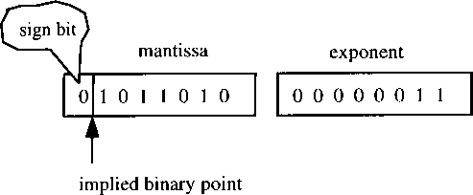
10.3 Binary: Floating Point Format
Scientific Notation: Floating Point Numbers
Binary: Floating Point Format
Floating Point in Decimal
Floating
Point in Binary
Expressing a number as a Mantissa and an Exponent allows us to store Floating Point numbers in a format that only requires whole numbers.
Sign = 1 bit.
Mantissa = 7 bits.
Exponent = 8 bit signed magnitude.
Total = 16 bits.
5.625₁₀
+101.1010₂
1.011010 x 2²

Slide 56
10.4 Floating Point in Decimal
Binary: Floating Point Format
Floating Point in Decimal
Floating
Point in Binary
What does 3.142₁₀ actually mean?
10⁰ | Point | ₁₀-1 | ₁₀-2 | ₁₀-3
1 |  | 1/10 | 1/100 | 1/1000
3 | . | 1 | 4 | 2
3.142 = (3 * 1) + (1 * 1/10) + (1 * 4/100) + (1 * 2/1000)
= 3 + 0.1 + 0.04 + 0.002

Slide 57
10.5 Floating Point in Binary
Floating Point in Decimal
Floating
Point in Binary
Limitation in Binary
Converting
Decimal to Binary
What is 1.101₂?
₂0 | Point | ₂-1 | ₂-2 | ₂-3
1 |  | 1/2 | 1/4 | 1/8
1 | . | 1 | 0 | 1
1.101₂ = (1 * 1) + (1 * 1/2) + 0 + (1 * 1/8)
1 + 0.5 + 0 + 0.125
= 1.625₁₀

Slide 58
10.6 Limitation in Binary
The Columns as we go RIGHT after the POINT have the place values.
Floating Point in Decimal
Floating
Point in Binary
Limitation in Binary
Converting
Decimal to Binary
1/2 | 1/4 | 1/8 | 1/16 | 1/32
0.5 | 0.25 | 0.125 | 0.0625 | 0.03125
When converting Floating Point decimal numbers to binary using a fixed number of places.
NOT ALL VALUES ARE POSSIBLE!

Slide 59
10.7 Converting Decimal to Binary
Binary: Floating Point Format
Floating
Point in Decimal
Floating Point in Binary
Limitation in Binary
Converting Decimal to Binary
Use continuous multiplication by 2.
Each 1 or 0 to the left of the point of the result contributes to the binary number.
Continue until the fractional part is 0.
Or until you obtain the answer to the accuracy you need.

Slide 60
10.7.1 Example: Decimal to Binary
Converting Decimal to Binary
Example: Decimal to Binary
How close is this answer to 0.35?
Take the Decimal Fraction: 0.35
0.35 | x | 2 | 0.70 | 0
0.70 | x | 2 | 1.4 | 1
0.4 | x | 2 | 0.8 | 0
0.8 | x | 2 | 1.6 | 1
0.6 | x | 2 | 1.2 | 1
0.2 | x | 2 | 0.4 | 0
Answer: | 0.35 = | 0.01011 | ...and so on
MSB
LSB

Slide 61
10.7.2 How close is this answer to 0.35?
0.010110₂
Example: Decimal to Binary
How close is this answer to 0.35?
10.8 Accuracy of Floating Point Data
₂0 |  | ₂-1 | ₂-2 | ₂-3 | ₂-4 | ₂-5 | ₂-6
0 | . | 0 | 1 | 0 | 1 | 1 | 0
0*2⁰ | 0
1* 2⁻² = 1* 0.25 | 0.25
1* 2⁻⁴ = 1* 0.0625 | 0.0625
1* 2⁻⁵ = 1* 0.0625 | 0.03125
 | 0.34375

Slide 62
10.8 Accuracy of Floating Point Data
Accuracy defined as closeness to true value.
Data is inputted to a program in Decimal floating point format (e.g. via the keyboard).
It is converted to a binary floating point format of fixed size.
This may involve some loss of accuracy.
Floating Point arithmetic is only approximate.
Integer arithmetic is exact.
Example: Decimal to Binary
How close is this answer to 0.35?
10.8 Accuracy of Floating Point Data

Slide 63
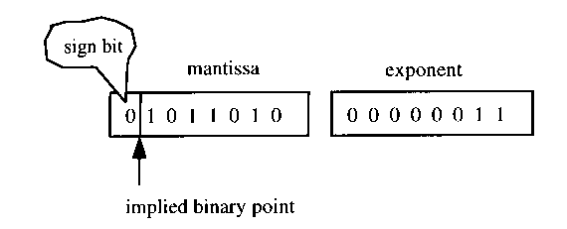
10 Storage Needs
10. Storage Needs
10.1. Precision
10.2. Range
10.3. Formats that have
been used
10.4. IEEE Format now
Used
10.5. Floating Point
Arithmetic
63

Slide 64
11.1 Precision
10. Storage Needs
10.1. Precision
10.2. Range
10.3. Formats that have
been used
10.4. IEEE Format now
Used
10.5. Floating Point
Arithmetic
Determined by the number of bits used to store the
Mantissa.
A high precision format will result in more accurate floating point arithmetic.
Most languages provide a choice:
Single precision.
Double precision.
64

Slide 65
10.2 Range
10. Storage Needs
10.1. Precision
10.2. Range
10.3. Formats that have
been used
10.4. IEEE Format now
Used
10.5. Floating Point
Arithmetic
The range of the format is how big and how small the numbers are that can be represented.
Determined by the number of bits used for the Exponent.
65

Slide 66
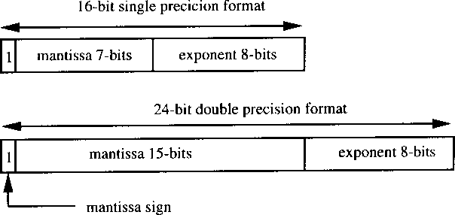
11.3 Formats That have been used
10. Storage Needs
10.1. Precision
10.2. Range
10.3. Formats that have
been used
10.4. IEEE Format now
Used
10.5. Floating Point
Arithmetic

Slide 67
11.4 IEEE Format now Used
IEEE 754 floating point standard.
Single Precision (32 bits):
Mantissa:
1 Bit for Sign / 23 Bits for Value.
Exponent:
8 Bits.
Double Precision (64 bits):
Mantissa:
1 Bit for Sign / 52 Bits for Value.
Exponent:
11 Bits.
10. Storage Needs
10.1. Precision
10.2. Range
10.3. Formats that have
been used
10.4. IEEE Format now
Used
10.5. Floating Point
Arithmetic

Slide 68
10.5 Floating Point Arithmetic
10. Storage Needs
10.1. Precision
10.2. Range
10.3. Formats that have
been used
10.4. IEEE Format now
Used
10.5. Floating Point
Arithmetic
Manipulating Floating Point numbers to do arithmetic is more complex than with Integer arithmetic.
Early processors only did Integer arithmetic – FP arithmetic was done in software.
Then math co-processors were introduced to do Floating Point calculations.
Now, most processors implement Floating Point instructions.
68

Slide 69
12. Summary
Representation of Numbers
IEEE Format
now used
Floating Point Arithmetic 12.Summary
Base/Radix: Hex and Octal
Non-integer numbers and Floating Point numbers.

Slide 70


